Slide 1

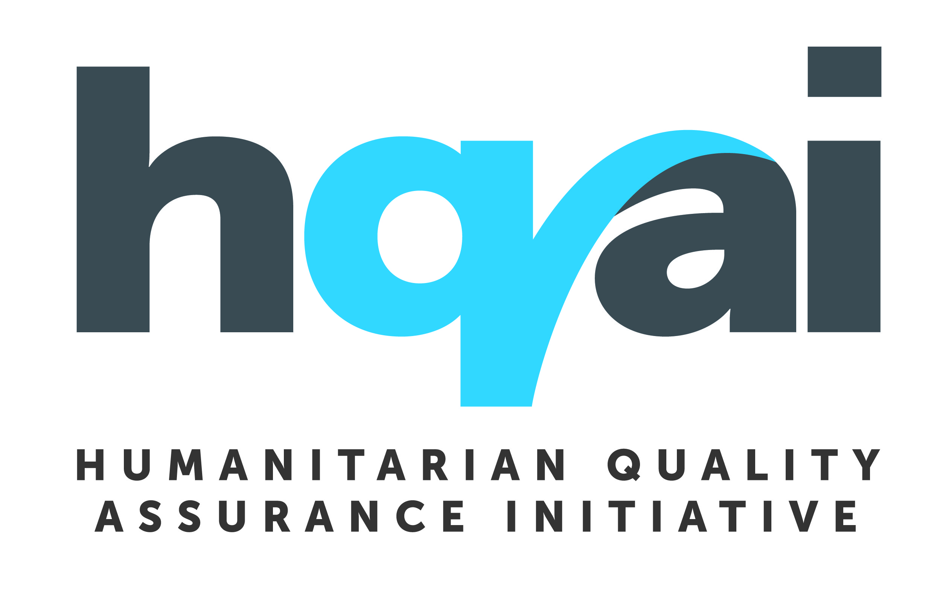

Reimaging Humanitarian Due Diligence: Learning together to move forward.
Introductions and experiences in passporting due diligence processes

Slide 2
Introductions

Slide 3
What if?
The sector was more explicit that due dilgence processes were to ensure the agency, safety, security, dignity, rights and voice of people affected by crisis?
Due diligence processes could bring equity between partners, moving away from power dynamics of donor and implementer?
There was a common accountability framework proven to cover a substantial part of most due diligence processes?
Over 200 organisations were already investing in measuring how they met that common framework through a supported process
The common framework had been developed in consultation with and ownership by national organisations and communities?

Slide 4
then be possible to....
See due diligence processes reinforce the notion of “putting people at the centre”?
Have a more equitable approach to partnerships that considers each partner's role in meeting community expectations?
Reduce duplication and lift the burden on implementing partners?

Slide 5
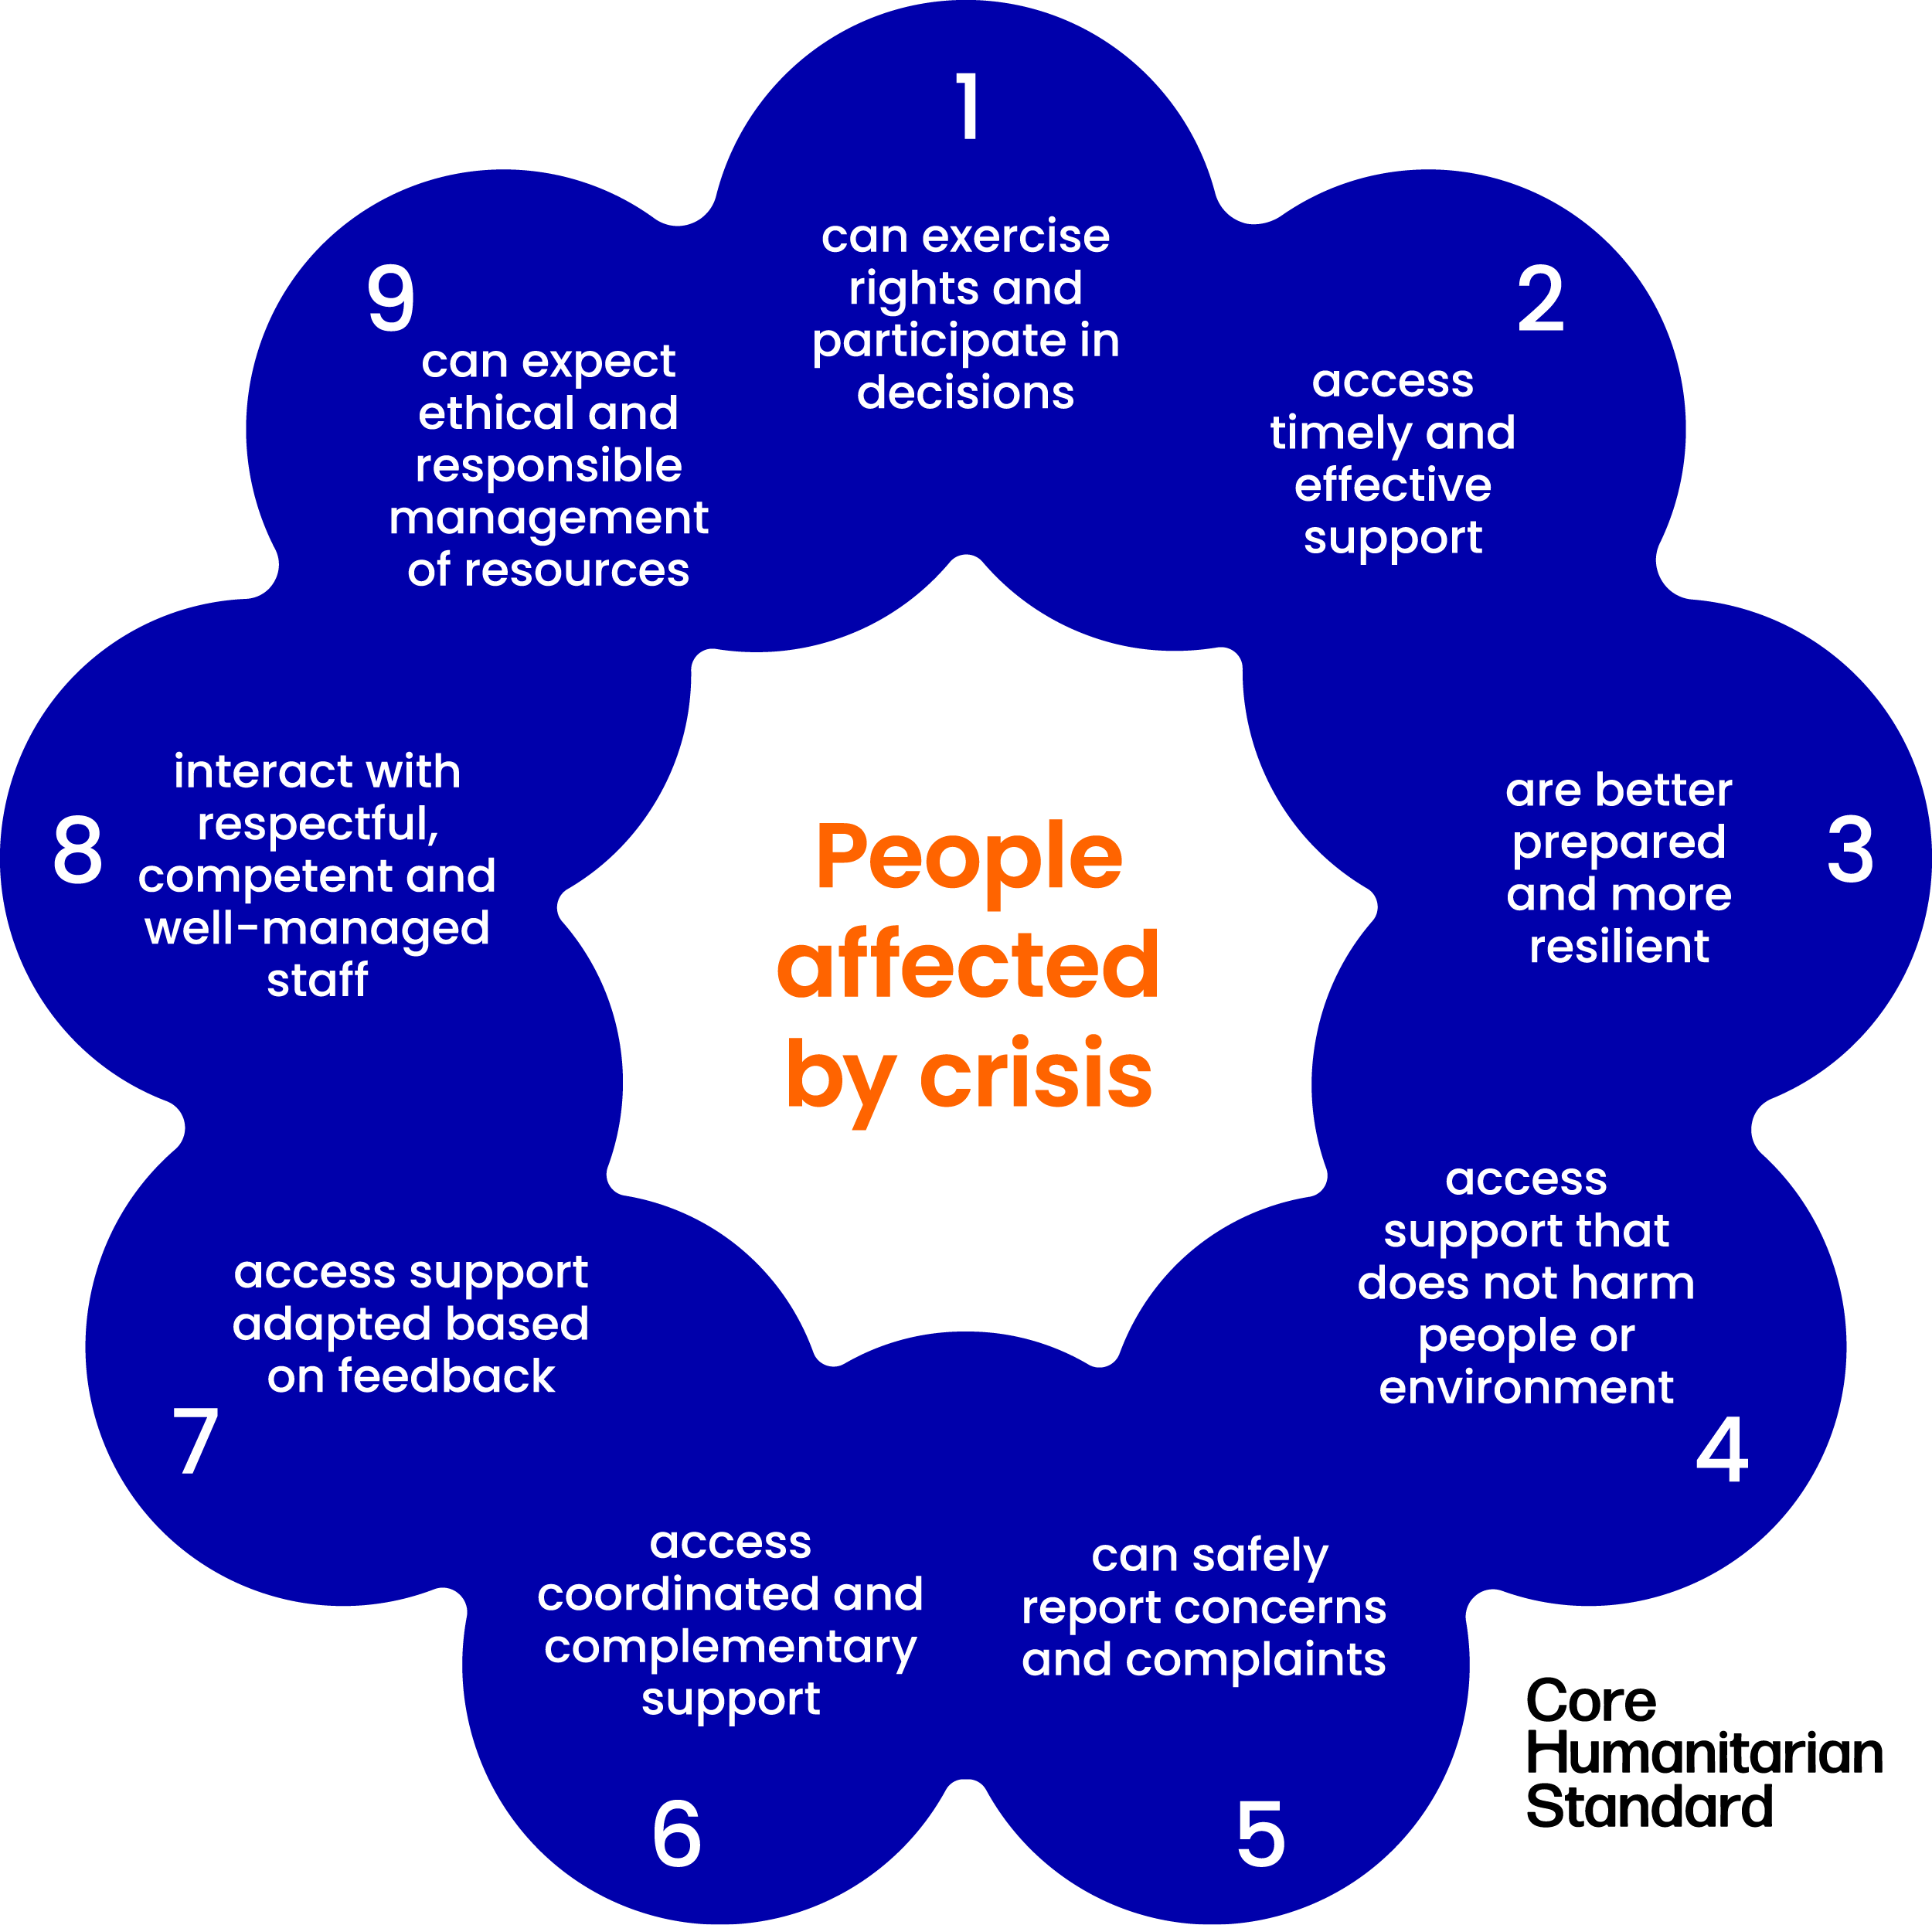
The Core Humanitarian Standard (CHS)
A verifiable, measureable standard for humanitarian and development actors

Slide 6
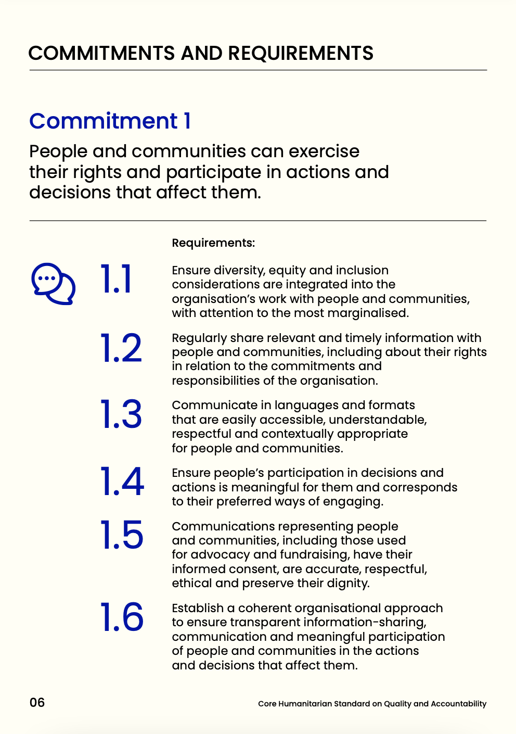
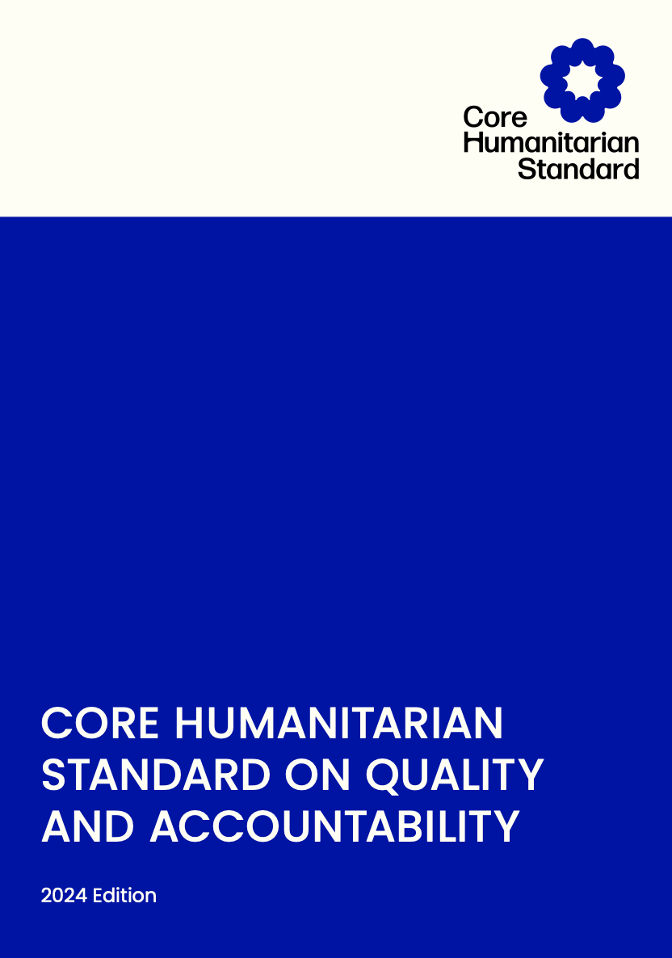
CHS Structure

Slide 7


Our members
At 1st January 2025
48% of members are National NGOs

Slide 8
Improved Delivery – CHS Verification Scheme
One purpose, three options
The Purpose of the Scheme is to improve the quality, effectiveness and accountability of development and humanitarian actions by supporting organisations with a standardised means to measure their application of the CHS
Self-Assessment
Led by the organisation itself. Helps organisations gain an understanding of their capacity and performance against the CHS
Independent Verification
Provides organisations with an independent, external quality assurance assessment of demonstrated, continuous and measurable progress against the CHS
Certification
Provides organisations with an independent, external quality assurance assessment and certification of compliance with the CHS

Slide 9
Verification scheme overview
Link to the Verification section and scheme can be found here
 | Self-Assessment | Independent Verification | Certification
Primary purpose | Demonstrate commitment and level of compliance | Independently assessed demonstration of commitment and level of compliance | Independently assessed demonstration of commitment and certification of compliance
List of indicators | CHS Verification framework
Life cycle | 2 years | 3 years
Implemented by... | The organisation itself | HQAI (www.hqai.org) trained CHS auditors
Controlled by… | CHS Alliance controls process | An Independent Conformity Assessment Body (currently HQAI), accredited under ISO/IEC standard 17065, controls process and findings
Who controls the controller? | Verification advisory Panel (VAP) & CHS Alliance Board | National Accreditation body - member of the International Accreditation Forum

Slide 10
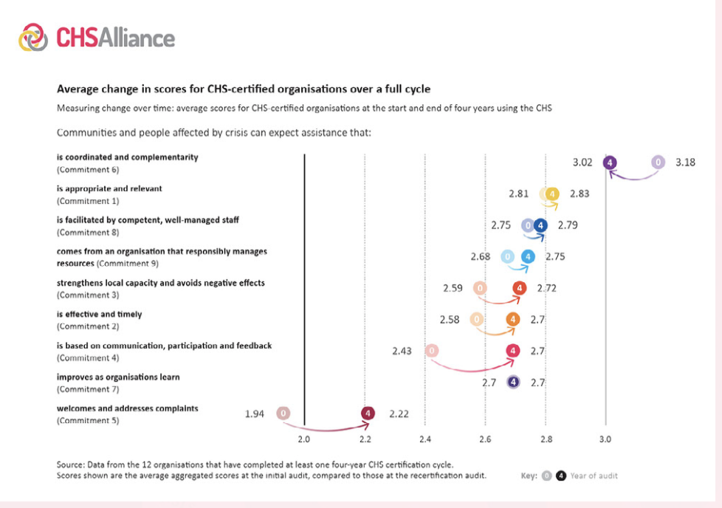
Creating Organisational Impact

Slide 11

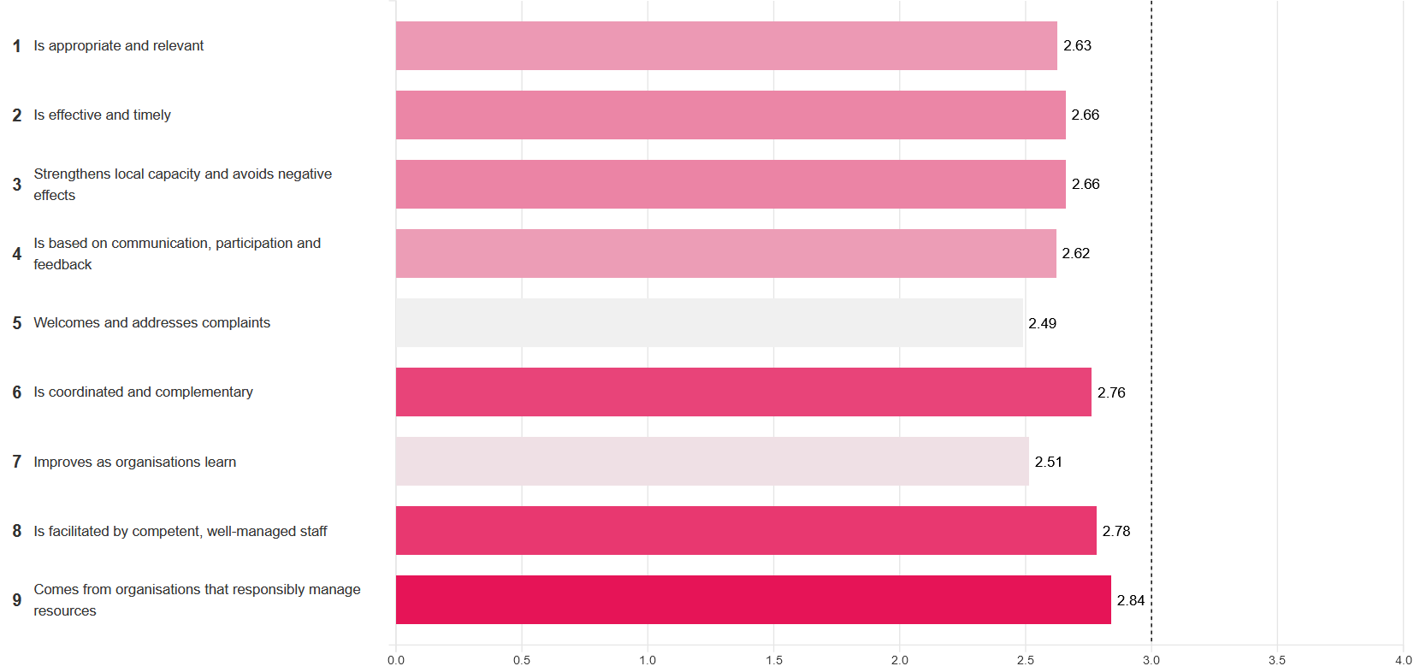
https://chstracker.chsalliance.org/s/

Slide 12
Uptake of CHS Verification in the sector
t
250+ organisations committed to CHS Verification
185 organisations verified to-date (45 certified, 35 independently verified, 105 Self-assessed). Over 30 national organisations verified.
410+ organisations worldwide show their commitment to the CHS!
Several donors encouraging or requesting partners to perform verification.

Slide 13
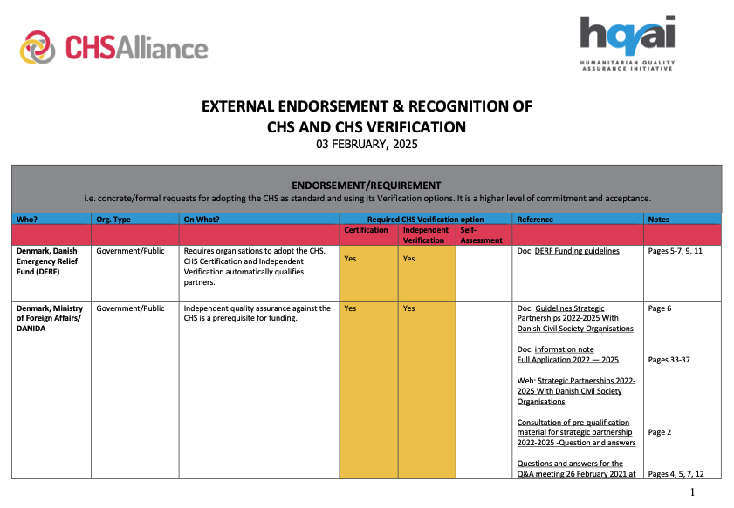











Focus Due Diligence (DD) – donor recognition and endorsement of the CHS
An increasing number of funders endorse the CHS, request verification against it, and recognise CHS Verification in their due diligence requirements.
See CHS Alliance and HQAI joint table of current funder recognition and endorsement.

Slide 14
Focus Due Diligence (DD) – donor recognition and endorsement of the CHS
Some examples of benefits indicated by donors
Value for Money Considerations
Economies of scale reduce duplication and save time and money.
Donor alignment leads to greater efficiencies.
Transparency and accountability are improved through online reports and CHS implementation.
Risk management and monitoring provide assurance and evidence of benefits.
Grand bargain commitments and gains in localisation are achieved.
Notes:
Aligning due diligence processes around trusted, independently verified standards—such as the Core Humanitarian Standard (CHS)—can unlock significant value for money benefits across donors portfolio. This is particularly relevant in the context of donor due diligence passporting, where CHS verification can be used as a recognised assurance tool to streamline and strengthen assessments.
This slide illustrates the chain of VfM benefits that result from integrating CHS Verification into donor systems:
Economies of Scale When multiple donors recognise a single, robust due diligence process such as CHS Verification, it reduces duplication across partners and funders. This minimises the administrative burden on local and international actors, saving both time and money.
Donor Alignment Using a common standard like CHS promotes harmonisation across donors, leading to greater efficiencies in how funding is monitored, assessed, and disbursed. This fosters consistency and predictability in compliance expectations.
Transparency & Accountability CHS Verification—supported by public CHS audit summaries —improves transparency in how organisations manage risks and deliver quality. This enables greater accountability to both affected populations and funding partners.
Risk Management & Assurance By embedding CHS verification into due diligence frameworks, donors gain independent, expert-led assurance on critical risk areas such as safeguarding, participation, and financial control. This enhances monitoring and gives donors greater confidence in delivery.
Support to Localisation & Grand Bargain Goals Finally, passporting CHS Verification as part of due diligence helps reduce access barriers for local and national NGOs, contributing to Grand Bargain commitments and wider localisation gains. This aligns with donor’s objectives to empower local leadership while maintaining quality and risk oversight.

Slide 15
3. Focus Due Diligence (DD) – identified coverage
HQAI has demonstrated that the evidence gathered during CHS audits inform various donor DD or partner capacity assessments to differing levels (50-100%). Using them as primary assurance in funders’ DD processes represents a way to reduce duplication.
The audit findings provide assurance in the following domains:
Safeguarding, PSEAH, code of conduct;
Complaint mechanisms and do no harm;
Governance and internal quality control;
Quality project management;
Downstream delivery with implementing partners.
In collaboration with CHS Alliance, HQAI works with governments, funding bodies, intermediaries to leverage efficiencies and achieve sector-wide savings (financial, admin, HR) without comprising on the accountability and quality or aid, nor the rigour of the assessment.

Slide 16
Focus Due Diligence (DD) – efficiency and cost-effectiveness examples
FCDO: CHS certified agencies can use existing HQAI audit reports to fulfil large parts of FCDO due diligence requirements.
HQAI CHS audits fully meet FCDO PSEAH due diligence requirements.
➩ Efficiencies in admin, HR and time for both, the funder and the agencies
➩ Value add for HQAI CHS certification audits
DANIDA: CHS Independent Verification and Certification are pre-requisites for funding (idem DEC and DRA).
Developing passporting pathways for Strategic Partnership application process 2025; 60% overlap identified.
➩ Strong support and recognition of the CHS as accountability, quality, safeguarding standard
➩ Plan to reduce duplication and seize inherent benefits from independent HQAI audits
DG ECHO: Accepting ex-ante assessments submitted by HQAI as auditor and based on CHS audits (HQAI bridge service).
ECHO recommends that all auditors can use HQAI audit reports to fill the ECHO ex-ante assessment.
➩ One audit, (almost) two requirements
West Africa: Scaling DD approaches and organisational capacity-strengthening approaches through a joint* regional project.
➩ Online passporting tool among intermediaries and with CHS audits: map, understand to take informed passporting decisions
➩ Access to funding: Sahel Regional Fund now passporting HQAI CHS audits for funding and as baseline for capacity strengthening
* ECHO-funded LoCAL project by DRC, HQAI, ICVA, SPONG

Slide 17
UN IP PSEA Capacity Assessment
HQAI has demonstrated that the information gathered through a CHS:2014 audit can be used to evidence meeting the requirements for each UN IP PSEA Capacity Assessment Standard (FCDO-HQAI pilot, 2022).
UN IPPWG and CHS Alliance have mapped the overlap with CHS:2024 requirements.
UN IP protocol: UN agencies share assessments and a common portal with the objective of reducing duplication and workload.
We are exploring 2 areas with IPPWG:
↠ Can CHS Verification reports (Self Assessment, Independent Verification, Certification) be submitted in lieu of an UN IP PSEAH Capacity Assessment?
↠ Can CHS audit reports support the UN organisation reviews used to make preliminary determination of partner capacity? i.e., is there appetite for additional efficiencies by using trusted evidence as passport?
Shared objective:
more efficient due diligence processes.

Slide 18

Room for discussion

Slide 19
Thank you.
Do contact us with any questions :
Jordi Capdevila - jcapdevila@chsalliance.org
Lola Adewunmi oadewunmi@chsalliance.org
Victoria Lyon Dean vlyondean@hqai.org

